Slide 1

Weather Hub
Yarin Schlesinger, Inal Taha, Itay Hirschel Doron

Slide 2
The Idea
Control the climate system through Home Assistant
Monitor Weather
Manage multiple properties, all concentrated in one place
Easily done with Weather Hub.

Slide 3




Track Weather
Get Notified on Extreme Weather Conditions
Activate Home Assistant Automations
Remotelty
Set Activity Hours for Air Conditioning
Save energy!
FEATURES
What Can Weather Hub do ?

Slide 4
HOW IT WORKS
The User's Experience
Set Your Device Settings and Automation Webhooks
Control Your Climate
Register the Devices Under Your Account
5
Create an Account and Log In
Get a Device
and place it
4
3
2
1

Slide 5
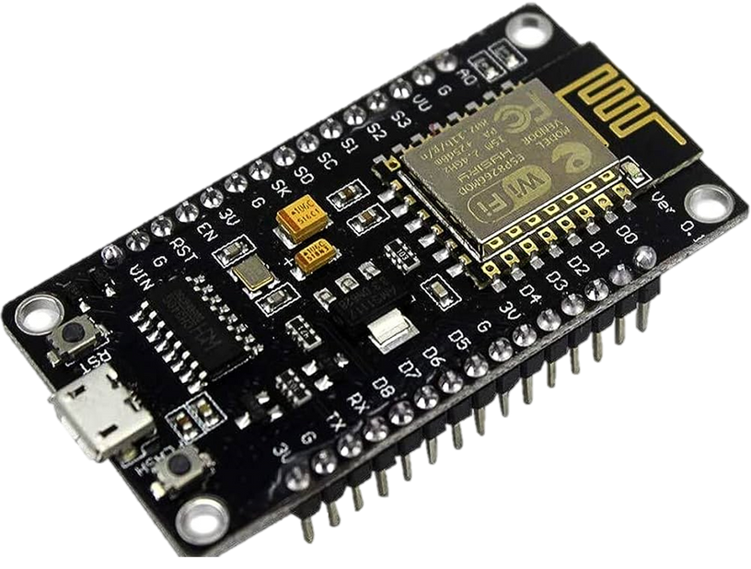
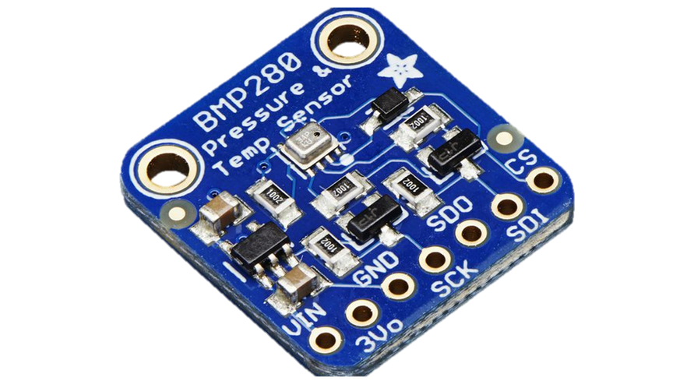
The Device
ESP8266 Board (With WiFi Antenna).
BMP280 Temperature and Air Pressure measure.

Slide 6




Cloud Services Used
Azure IoT Hub
For managing cloud to device messages.
Azure signalR Service
For syncing the information received on the app with the information stored on the cloud. Received immediate notification on extreme conditions measured by the device.
Azure Storage : Data Tables
For storing data.

Slide 7

Cloud Services Used
Azure Functions
HTTP Trigger
For activating most of the functions
Event Grid Trigger
For activating an automation through another function.
Timer Trigger
For supporting the automatically managed AC activity hours.

Slide 8


Cloud Services Used
Event Grid
An Event Grid topic to activate an azure function.
Azure Maps
Getting coordinates for given address, and getting current weather conditions at said coordinates.

Slide 9
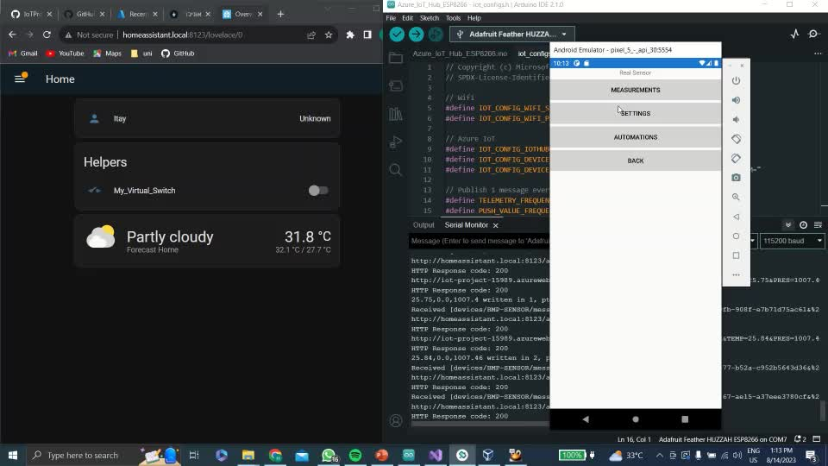
Managing Climate
Managing your property climate is done through communicating with a home assistant system.
Home Assistant features a service which runs automations through an HTTP request on your local WiFi Network (Webhook triggered automations)

Slide 10

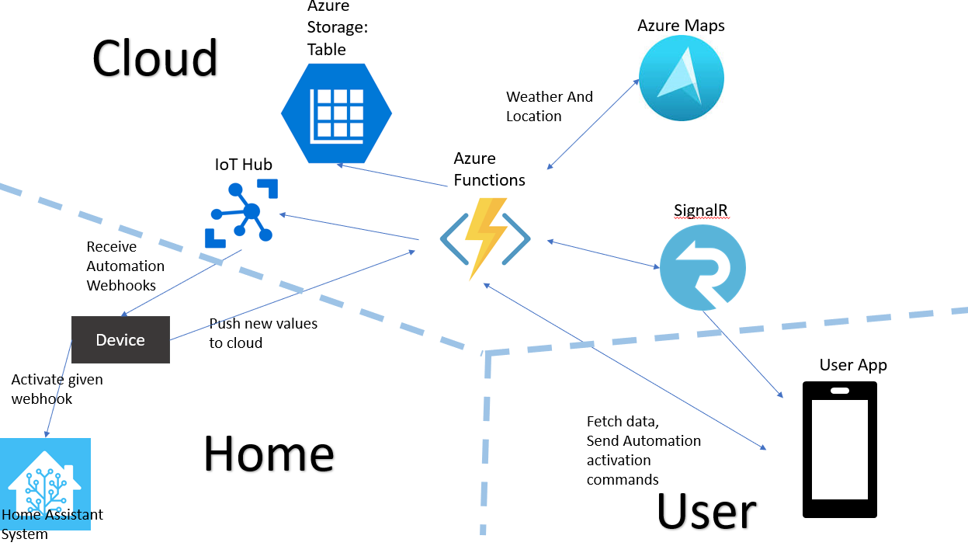
Architecture

Slide 11
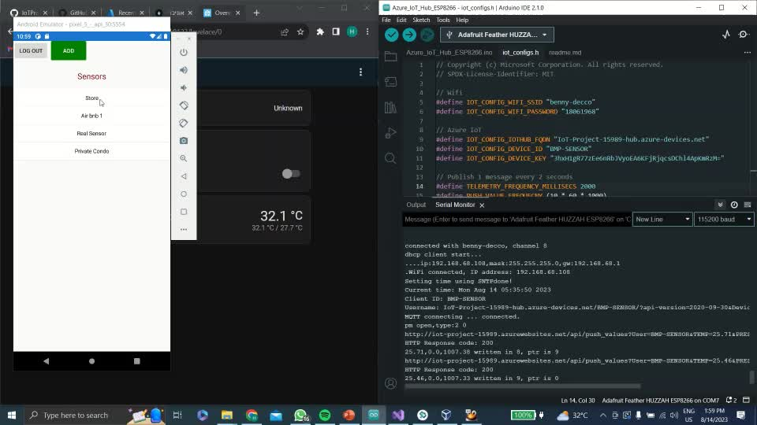
Setting Activity Hours

Slide 12

Automatic Climate Managing

Slide 13
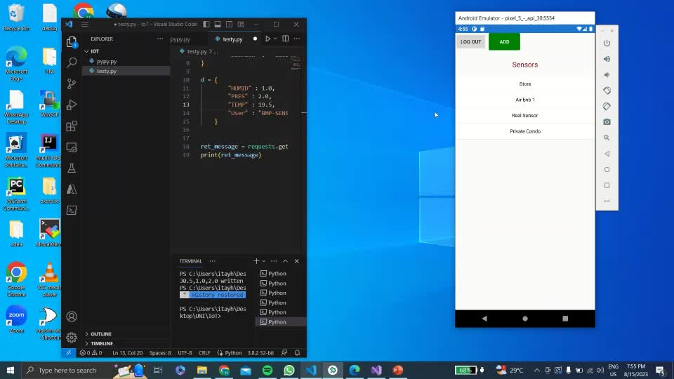
Notification Demonstration

